Slide 1
Design and Diversity

Slide 2
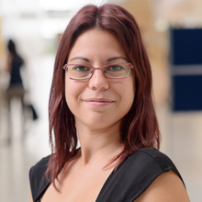
Vasiliki Mylonopoulou, PhD
Computer Engineering in Greece
Human-Computer Interaction in Umeå, Sweden
PhD in Information Processing Science in Oulu, Finland
Design technology for health behaviour change through social influence.
Division of Human-Computer Interaction Department of Applied IT
More about Vasiliki: https://vasilikimylo.com/
Contact Vasiliki Vasiliki.mylonopoulou@ait.gu.se

Slide 3
The plan for the day
9.00 – 9.15 Introductions
9.15 – 9.45 Discussion stations
9.45 – 10.45 Human-Computer Interaction and the Patient-Centric care
10.45 – 11.00 Break
11.00 – 11.30 A design process in detail
11.30 – 12.00 Discover – Create a persona
12.00 – 13.00 Lunch
13.00 – 14.30 Define – Create a scenario and define the problem
13.30 – 14.00 Presentations and wrapping up

Slide 4
Introduction to Human-Computer Interaction

Slide 5
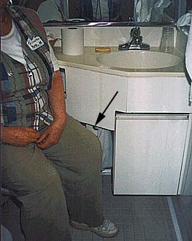
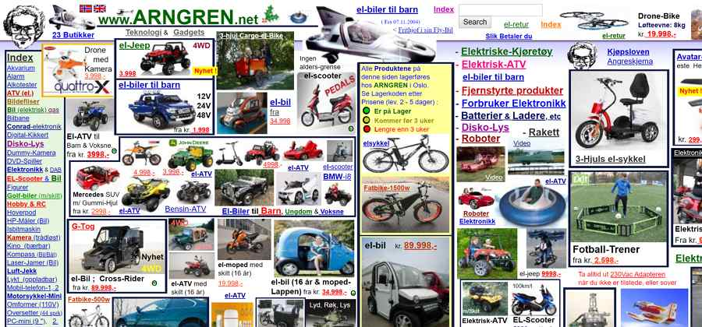
The good, THE BAD,... And the Evil
Notes:
Bad designs
http://www.baddesigns.com/examples.html

Slide 6
The good, the bad,... And THE EVIL
Notes:
https://www.darkpatterns.org/

Slide 7
THE GOOD, the bad, and the evil
Notes:
Good designs
https://jnd.org/tag/in_praise_of_good_design/
Videodeck Design
https://link.springer.com/article/10.1007/s00779-004-0293-8

Slide 8
Experiences of Bad/Good Designs

Slide 9
Human-Computer Interaction basics
Picture by: Interaction design Beyond Human-Computer Interaction, 5th Edition (2019) by Helen Sharp, Jennifer Preece, Rogers Yvonne
Notes:
Fisrst 11 chapters of the book Interaction Design:
https://www.youtube.com/watch?v=vXemvrfytcM&list=PLZJO8uYi0aTH18GiHj23feaBjRAumTM3z
Free material related to the book:
http://www.id-book.com/help.php
Introduction to HCI: https://www.youtube.com/watch?v=ffA0ZJeSRFc&list=PLZJO8uYi0aTGRGBxgTYFF01eXyLvSCcfZ

Slide 10
Hawaii
Notes:
https://www.nngroup.com/articles/error-prevention/

Slide 11
Simple but complex
User research
Prototype
Evaluate

Slide 12
What is really design?
Image by thedesignsquiggle.com/
Notes:
The image: https://thedesignsquiggle.com/

Slide 13
What is the most important thing in the design process?
Reflection
Notes:
Schön, D. A. (2017). The reflective practitioner: How professionals think in action. Routledge. engineering, architecture, management, psychotherapy, and town planning - to show how professionals really go about solving problems. Boland, R., & Collopy, F. (Eds.). (2004). Managing as designing (p. 298). Stanford, CA: Stanford business books.

Slide 14
Questions?

Slide 15
User-centred Design
The user is the focus
User’s, needs, wishes, actions, context, behaviour etc are taken into consideration
Wholistic view of the user
The final product/ design is a negotiation between the designer and the user.
Nelson, H. G., & Stolterman, E. (2014). The design way: Intentional change in an unpredictable world. MIT press.
Notes:
Nelson, Harold G., and Erik Stolterman. The design way: Intentional change in an unpredictable world. MIT press, 2014.

Slide 16
Designer’s rationale in wellness apps for “patients”
Mylonopoulou, V., Väyrynen, K., Stibe, A., & Isomursu, M. (2018, April). Rationale behind socially influencing design choices for health behavior change. In International Conference on Persuasive Technology (pp. 147-159). Springer.
Notes:
Prostate cancer – Breast cancer Mylonopoulou, V., Väyrynen, K., Stibe, A., & Isomursu, M. (2018, April). Rationale behind socially influencing design choices for health behavior change. In International Conference on Persuasive Technology (pp. 147-159). Springer.

Slide 17
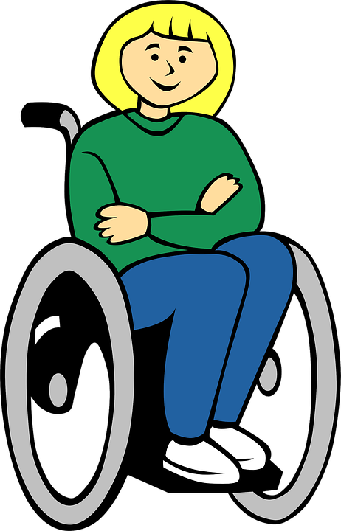
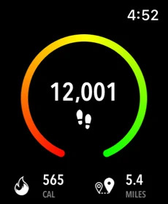
When health and wellness is not covered in design
Notes:
Calory burn – walkers vs wheelchair users

Slide 18
Questions?

Slide 19
Person centric care
The user is the focus
User’s, needs, wishes, actions, context, behaviour etc are taken into consideration
Wholistic view of the user
The final product/ design is a negotiation between the designer and the user.
It is a philosophy
Focused on the “patient”, and understand their needs, wishes, context etc
Wholistic view of the “patient”
Respect to “patient”’s choice
Empower them to make a choice
Change in perspectives and philosophy of the organisation as a whole
Notes:
Try to click on the pdf option that pops up on the right of the screen
Morgan, S., & Yoder, L. H. (2012). A concept analysis of person-centered care. Journal of holistic nursing, 30(1), 6-15. https://doi.org/10.1177/0898010111412189

Slide 20
Discussion
How can the person-centric care influence the design process of digital health?
How can technology designed with user-centre approach can support the person-centric care?
How can technology contribute to the empowerment of the “patient”? What are the ethical implications?

Slide 21
Break
15 min

Slide 22
Tools for design
User research
Prototype
Evaluate

Slide 23
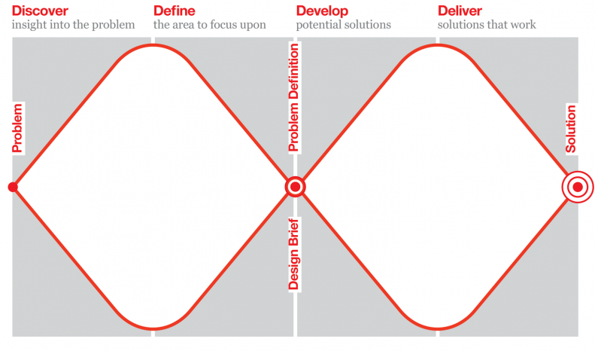
Double diamond
By www.designcouncil.org.uk
Notes:
Related resourses
https://www.designcouncil.org.uk/news-opinion/what-framework-innovation-design-councils-evolved-double-diamond

Slide 24
Discover
...user’s, needs, wishes, actions, context, behaviour
Involving users (optimal)
Interviews
Observations & participant observations
Contextual Inquiry
Cultural probes
Workshops (roleplay, co-creation/co-exploration)
Diaries
Surveys and questionnaires
Not involving users (not optimal)
Scientific literature
YouTube videos presenting users narrating or discussing their issues
Online communities of the specific users and internet scraping
Articles from journals and newspapers
Documentation of data in the (healthcare) systems and (national) statistics
Notes:
Interviews see chapter 7: Patton, M. Q. (2014). Qualitative research & evaluation methods: Integrating theory and practice. Sage publications.
Cultural probes: Gaver, B., Dunne, T., & Pacenti, E. (1999). Design: cultural probes. interactions, 6(1), 21-29. http://www.itu.dk/~malmborg/Interaktionsdesign/Kompendie/Gaver_Dunne_Pacenti.pdf A case of roleplay to understand users: Matthews, M., Gay, G., & Doherty, G. (2014, April). Taking part: role-play in the design of therapeutic systems. In Proceedings of the SIGCHI conference on human factors in computing systems (pp. 643-652).

Slide 25
Define...
...what are the issues you need to resolve?
Analysis of the data
Affinity diagram
Thematic analysis
Co-ideation workshops
Visualisation of the data
Persona creation
Scenario creation
User story
Futuristic scenarios
Use case
Notes:
Use cases focus on functional requirements and capture interaction. Use cases define a specific process because they are a step-by-step description. This is in contrast to a user story, which focuses on outcomes and user goals.

Slide 26
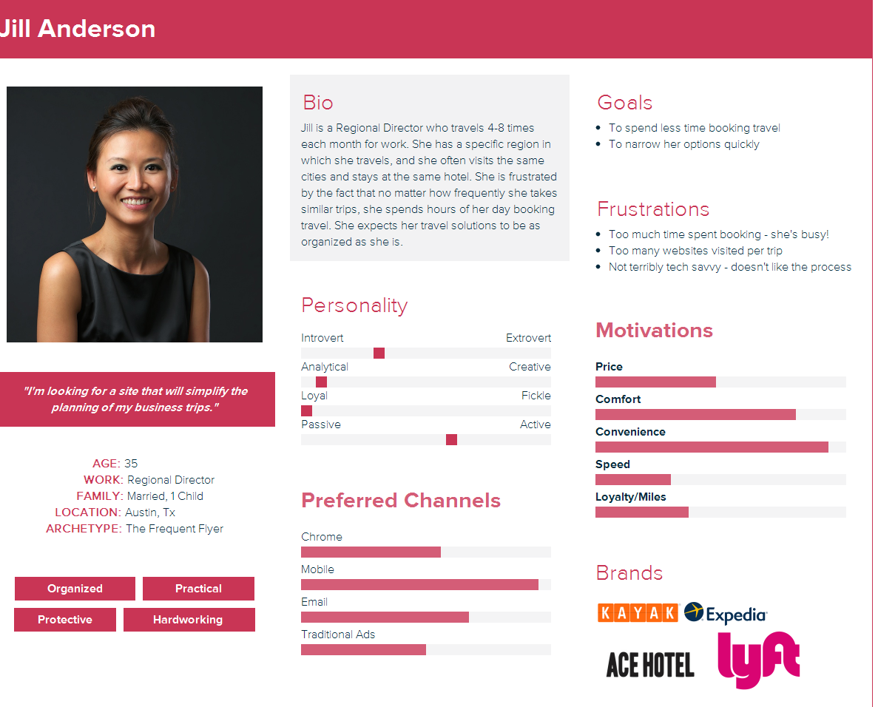
Persona
Important characteristics
Image
Name
Quote
Short bio
Likes/dislikes
Notes:
Representation of the users
Not based on statistical data but made as realistic as possible
They aim to increase empathy
They are used to help the design team to focus on the user

Slide 27
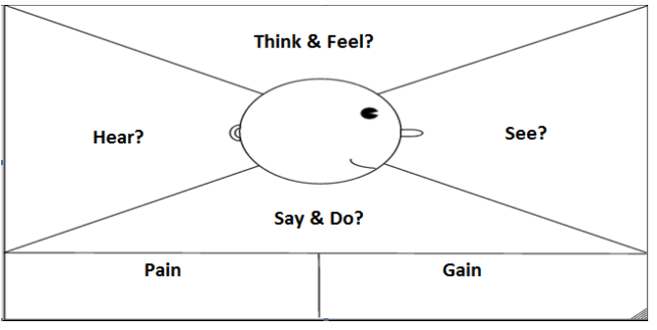
Empathy: Persona with empathy map
Ferreira, B., Silva, W., Oliveira, E., & Conte, T. (2015, July). Designing Personas with Empathy Map. In SEKE (Vol. 152).
Notes:
Empathy persona:
Ferreira, B., Silva, W., Oliveira, E., & Conte, T. (2015, July). Designing Personas with Empathy Map. In SEKE (Vol. 152).

Slide 28
Scenario

Slide 29
Develop
Evaluation
Experts
Cognitive walkthroughs
Heuristic evaluation
Users
Think-Aloud
Wizard of Oz
Usability testing
User experience testing
A/B testing
Co-exploration
Interviews, observations etc
Different levels of prototyping
Paper prototyping
Mockup
Wireframe
Semi-functional prototype
Functional prototype
Notes:
Evaluation methods: https://www.allaboutux.org/all-methods
Inspection (evaluation) Methods – expert based Heuristic evaluation
https://www.nngroup.com/articles/ten-usability-heuristics/
More videos on Heuristic evaluation by Nngroup: https://www.youtube.com/watch?v=cTtc90jCULU
Example with a paper prototype:
https://youtu.be/MkyI0gmwfUY
Cognitive walkthoughs:
https://www.interaction-design.org/literature/article/how-to-conduct-a-cognitive-walkthrough
Empirical (evaluation) methods – with users
Think-Aloud:
https://www.nngroup.com/articles/thinking-aloud-the-1-usability-tool/ Example: https://www.youtube.com/watch?v=pxsJkAk_eo0

Slide 30
Your Turn!
Design wellness technology or a system for wheelchair users with spinal cord injury
It can include ideas on calory consumption, “step” counting and daily activity , accessible places (gym or cafes or roads) map, exercise tracking, etc
Design technology or a system for People with multiple sclerosis
It can include, tracking of symptoms (physical or cognitive), visualising fatigue state to friends and family, doctor – patient communication, support for task management, support for taking rest/breaks.

Slide 31
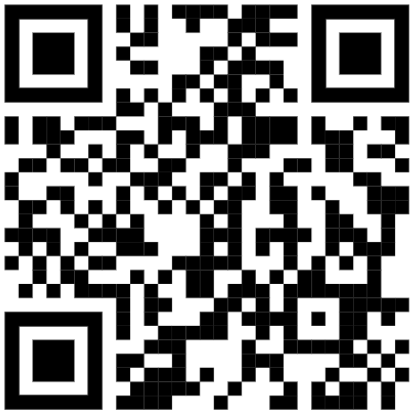
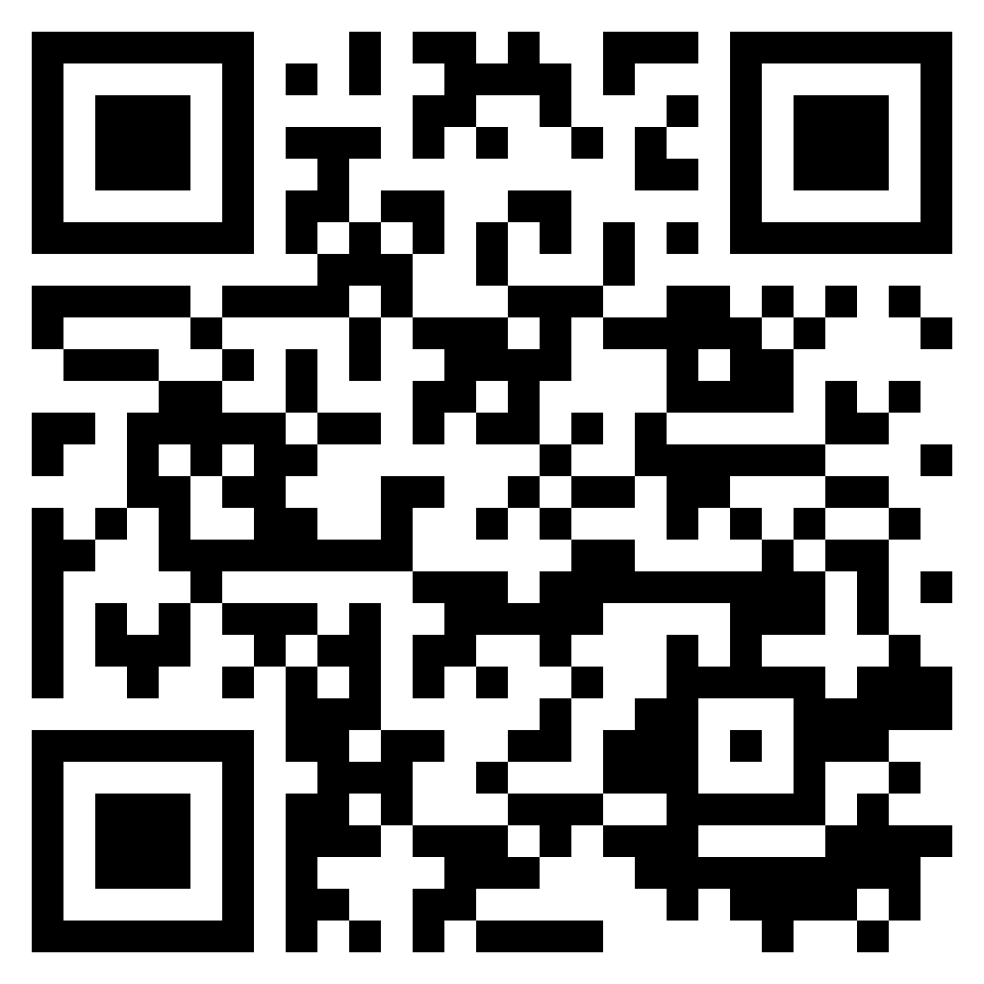
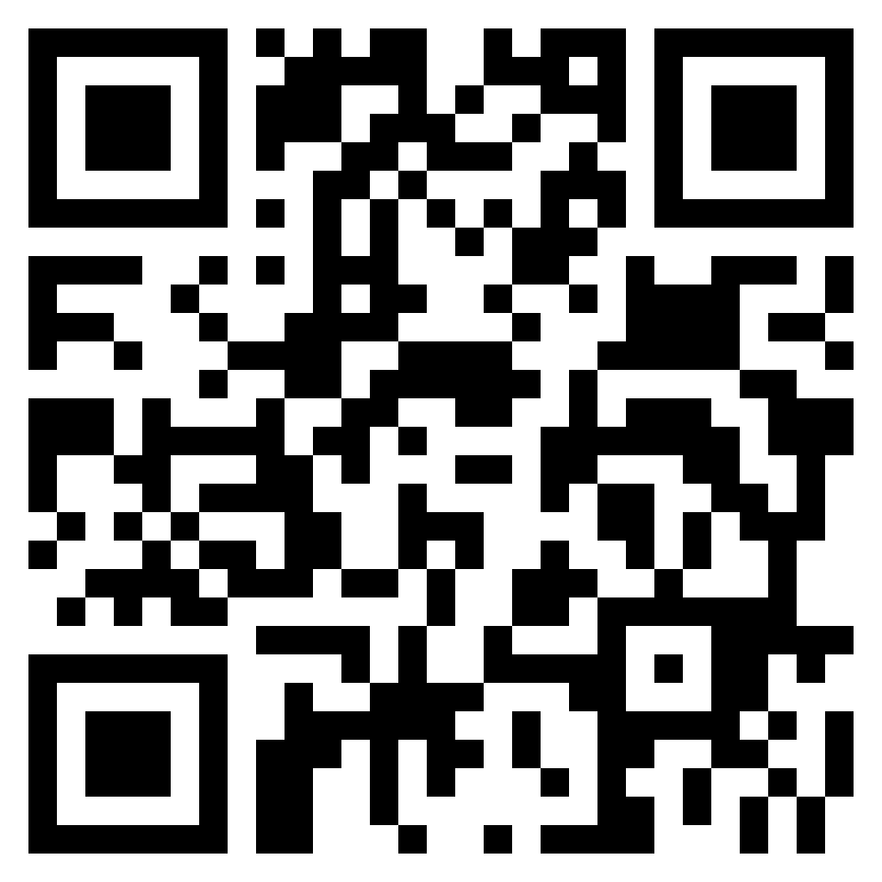
Personas
https://xtensio.com/templates/
https://miro.com/ templates/personas/
https://www.mural.co/ templates/persona-profile
Notes:
Use cases focus on functional requirements and capture interaction. Use cases define a specific process because they are a step-by-step description. This is in contrast to a user story, which focuses on outcomes and user goals.

Slide 32
It is not only the double diamond

Slide 33
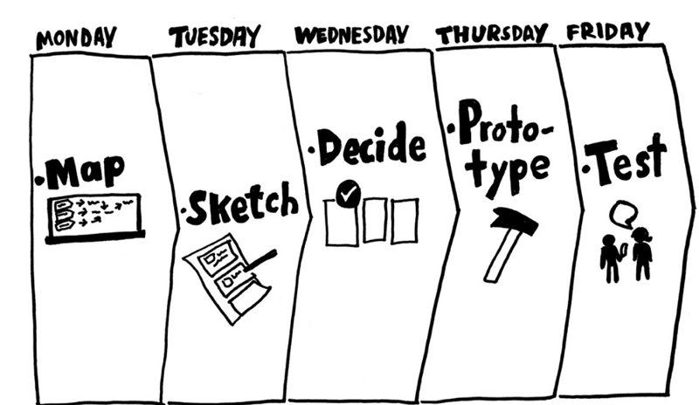
Design sprint by Google
Notes:
Knapp, J., Zeratsky, J., & Kowitz, B. (2016). Sprint: How to solve big problems and test new ideas in just five days. Simon and Schuster.

Slide 34
Notes:
Read more: https://www.interaction-design.org/literature/article/5-stages-in-the-design-thinking-process

Slide 35
Thank you for today!

Slide 36
The plan for the day
9.00 – 10.00 Diversity and Technology
10.00 – 11.30 Normal, AI and the digital society
11.30 – 12.00 Experience the “other”
12.00 – 13.00 Lunch
13.00 – 13.30 Discussion on Empathy
13.30 – 14.00 Wrap up & details about the one credit

Slide 37
We affect people’s lives
By designing the (digital) world

Slide 38
Context

Slide 39
Are you familiar with…
Notes:
The 2030 Agenda for Sustainable Development, adopted by all United Nations Member States in 2015, provides a shared blueprint for peace and prosperity for people and the planet, now and into the future.
Leave no one behind (LNOB) is the central, transformative promise of the 2030 Agenda for Sustainable Development and its Sustainable Development Goals (SDGs). It represents the commitment of all UN Member States to eradicate poverty in all its forms, end discrimination and exclusion, and reduce the inequalities and vulnerabilities that leave people behind and undermine the potential of individuals and of humanity as a whole.
Related literature
Sustainable goals:
https://en.wikipedia.org/wiki/Sustainable_Development_Goals
https://sdgs.un.org/goals
Leave no one behind:
https://www.un.org/development/desa/disabilities/envision2030.html
https://unsdg.un.org/2030-agenda/universal-values/leave-no-one-behind

Slide 40
Let’s Walk our privilege
Notes:
https://peacelearner.org/2016/03/14/privilege-walk-lesson-plan/

Slide 41
Equality, Equity, Justice

Slide 42
It is not just a matter of accessibility

Slide 43
Technology

Slide 44
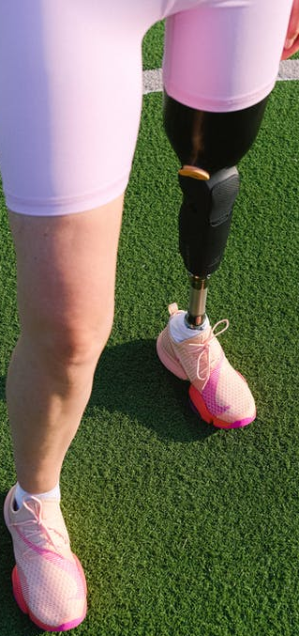
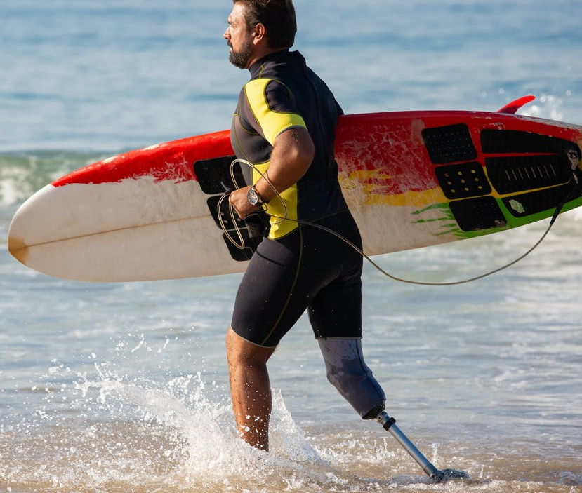
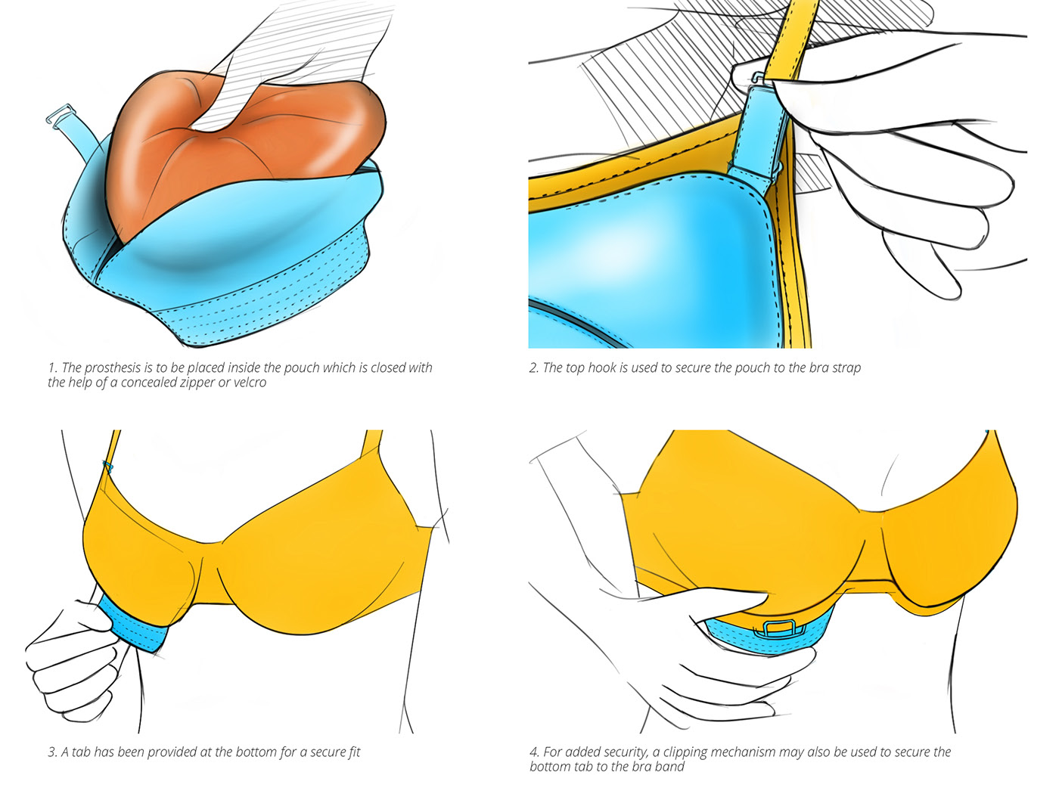
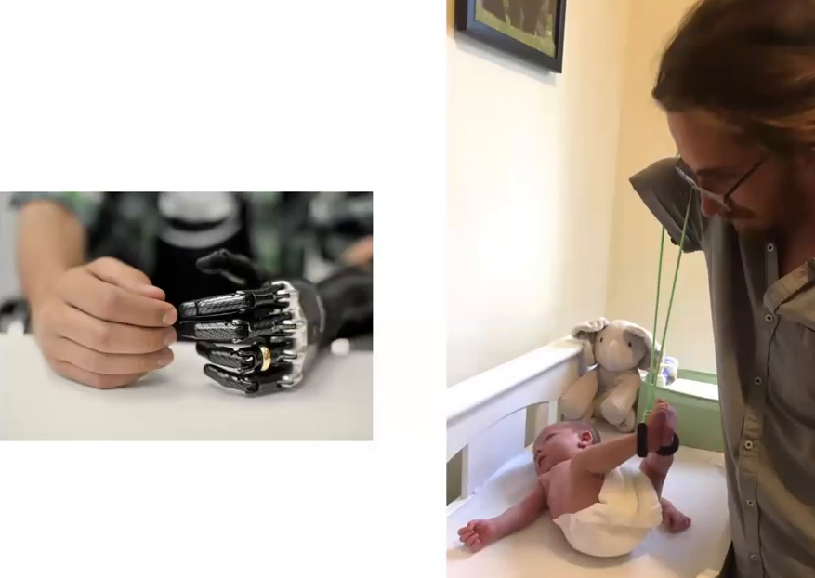
Prosthetics
Cost-effective Prosthesis for Breast Cancer Survivors by Yuhina L. Lachungpa
https://www.behance.net/gallery/37058341/Cost-effective-Prosthesis-for-Breast-Cancer-Survivors
What Can a Body Do? How We Meet the Built World
presented by Foster Young, Sara Hendren
in New America
on 08/19/2020 http://opentranscripts.org/transcript/what-can-a-body-do/
https://youtube.com/shorts/niIsf-dQ0Pc?feature=share
Notes:
Related literature
What Can a Body Do? How We Meet the Built World presented by Foster Young, Sara Hendren in New America on 08/19/2020 http://opentranscripts.org/transcript/what-can-a-body-do/
Cost-effective Prosthesis for Breast Cancer Survivors by Yuhina L. Lachungpa https://www.behance.net/gallery/37058341/Cost-effective-Prosthesis-for-Breast-Cancer-Survivors

Slide 45
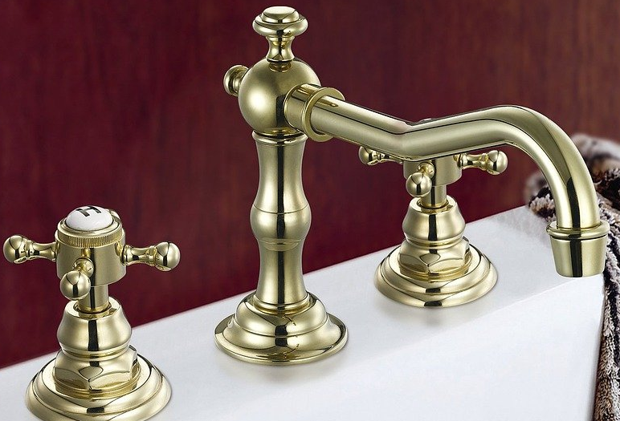
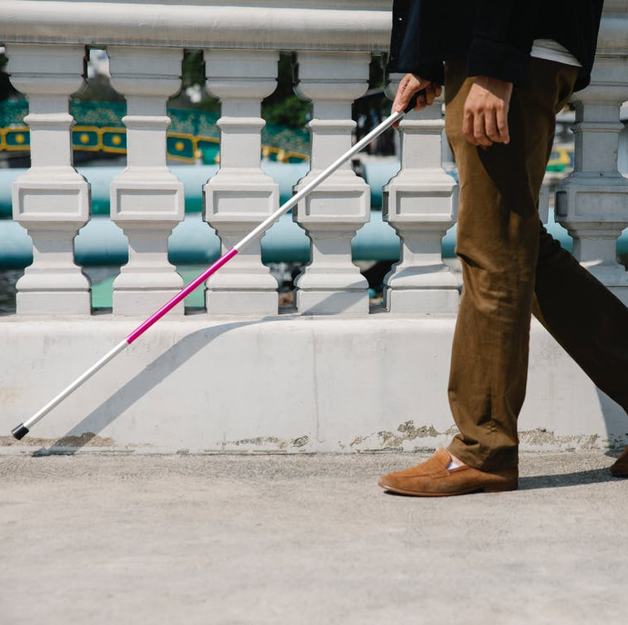
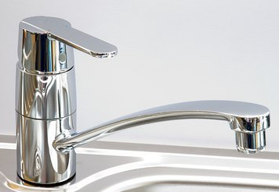
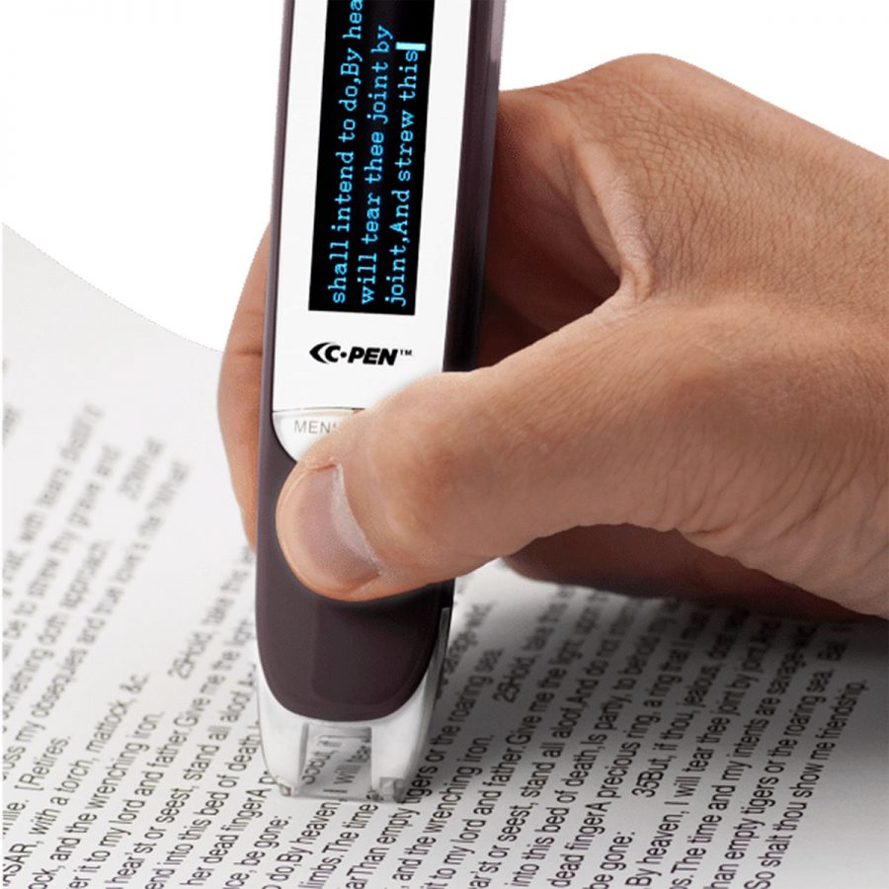
Assistive technology
Spot the intruder
Lingopen by c-Pen
Braille - PC Nero Slim Line Keyboard

Slide 46
For whom are you working?
What Can a Body Do? How We Meet the Built World
presented by Foster Young, Sara Hendren
in New America
on 08/19/2020 http://opentranscripts.org/transcript/what-can-a-body-do/
Cost-effective Prosthesis for Breast Cancer Survivors by Yuhina L. Lachungpa
https://www.behance.net/gallery/37058341/Cost-effective-Prosthesis-for-Breast-Cancer-Survivors
Notes:
TEDx video: https://www.youtube.com/watch?v=5t7kFRQ5S-4
About prosthetics, testimonies
https://www.inputmag.com/culture/cyborg-chic-bionic-prosthetic-arm-sucks
https://www.limbs4life.org.au/news-events/news/bionic-solutions-too-good-to-pass-or-too-bad-to-grab

Slide 47
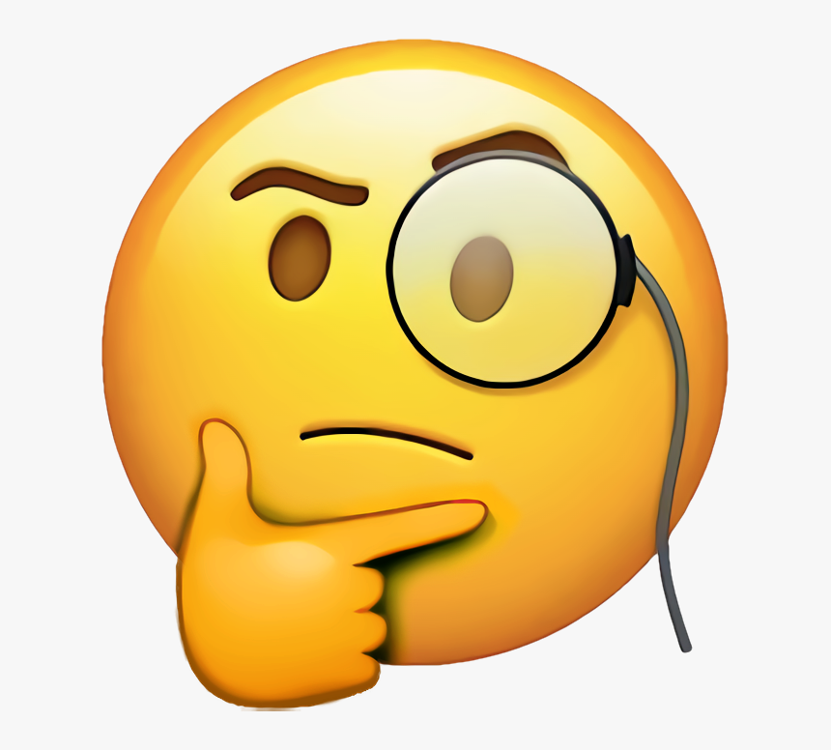
Thinking excersise
What does the word “normal” mean for you?
How do you think our perception of normal influence our understanding of the users?
How do you perceive the term “assistive technology”?

Slide 48
Let’s talk about unicorns
Notes:
A real person living in a world designed for unicorns
https://www.vasilikimylo.com/post/a-real-person-living-in-a-world-designed-for-unicorns

Slide 49
Who is Normal?
15% of the global population live with disabilities
45% by 2030
77% in European region live with NCDs
44% in Canada
45% in USA
Notes:
References for these data can be found at the blogpost: a real person living in a world designed for unicorns
https://www.vasilikimylo.com/post/a-real-person-living-in-a-world-designed-for-unicorns

Slide 50
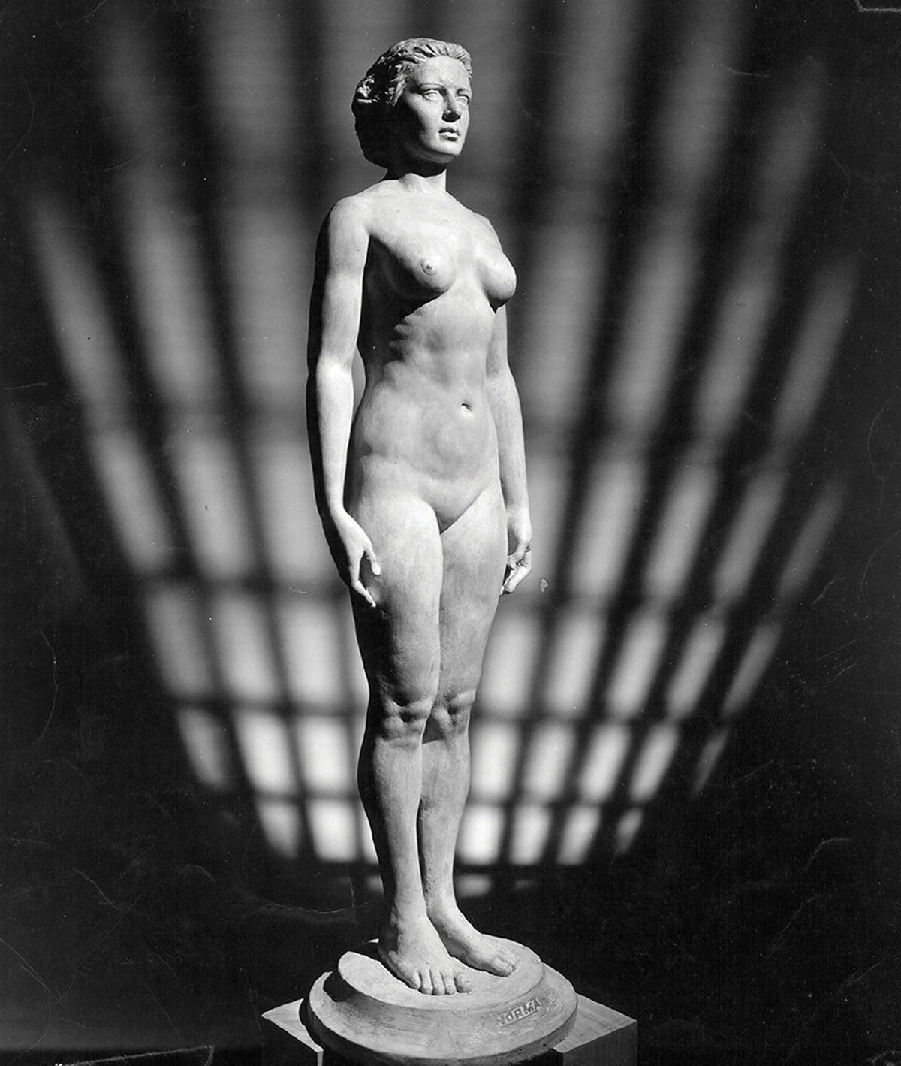
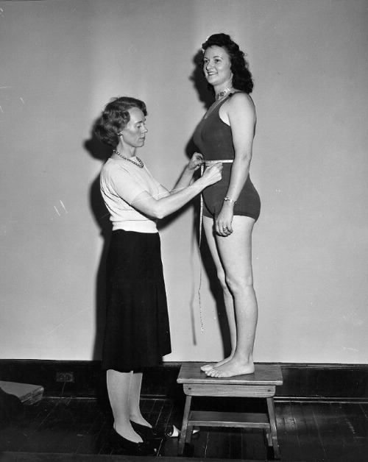
Is this normal?
Images taken from https://sashaarchibald.com/Norm-Norma
Notes:
carved in 1943 as exact replicas of the average American man and woman.
The statues were the work of Robert Latou Dickinson
More about Norm/Norma:
https://www.cabinetmagazine.org/issues/15/cambers.php
https://sashaarchibald.com/Norm-Norma

Slide 51
This is Normal
Normal Sucks: How to Live, Learn, and Thrive, Outside the Lines by Jonathan Mooney
Notes:
Video: https://www.youtube.com/watch?v=Brjx27Vm5x8
Refered book: https://www.amazon.com/Normal-Sucks-Learn-Thrive-Outside-ebook/dp/B07CRN9G1N
Homosexuality as medical condition before and after: https://en.wikipedia.org/wiki/Homosexuality_in_DSM

Slide 52
A leter

Slide 53
It is not just a matter of accessibility

Slide 54
What is Disability?
Notes:
Who is the problematic here?
What if the person hearts themselves?

Slide 55
Able woman disable men!
Notes:
Woman video: https://www.youtube.com/watch?v=Spb0bo3IT0I
Men video: https://www.youtube.com/watch?v=DUwXN01ARYg

Slide 56
Ability, and democracy (2017)
Notes:
2017 in E.U. parliament: Of course women should get paied less
https://www.youtube.com/watch?v=40hhc0cjYyg

Slide 57
Misconceptions
Notes:
Video link: https://youtu.be/fEhKoeEEgCo

Slide 58
How do we build our digital world?
Notes:
Related article: Bhargava, R. (2018). The Algorithms Aren't Biased, We Are. Medium.
Suggested video by a participant: https://www.youtube.com/watch?v=C7avHQEhYoI

Slide 59
Models of disability
Moral model of disability: people are morally responsible for their own disability. For example, the disability may be seen as a result of bad actions of parents if congenital, or as a result of practicing witchcraft if not
Medical Model of Disability: viewing disability as a problem of the person, directly caused by disease, trauma, or other health condition which therefore requires sustained medical care provided in the form of individual treatment by professionals.
Social model of disability: sees the issue of "disability" as a socially created problem and a matter of the full integration of individuals into society.
Sourse: https://www.disabled-world.com/definitions/disability-models.php
Notes:
Sourse: https://www.disabled-world.com/definitions/disability-models.php

Slide 60
World Health Organization
Disability refers to the interaction between individuals with a health condition and personal and environmental factors
Sourse: https://www.who.int/news-room/fact-sheets/detail/disability-and-health
Notes:
Sourse: https://www.who.int/news-room/fact-sheets/detail/disability-and-health

Slide 61
Identity: Everyone Here Spoke Sign Language…
Notes:
Music in the deaf space – experience of music
Video link
https://www.youtube.com/watch?v=u12uKwSwX3k
Suggested literature Everyone Here Spoke Sign Language
https://www.amazon.com/Everyone-Here-Spoke-Sign-Language/dp/067427041X

Slide 62
Thinking excersise
What did you find interesting from this part of the presentation?
What did you have hard time to perceive? Why do you think you have hard time to perceive it?
What is the risk with AI and learning algorithms?

Slide 63
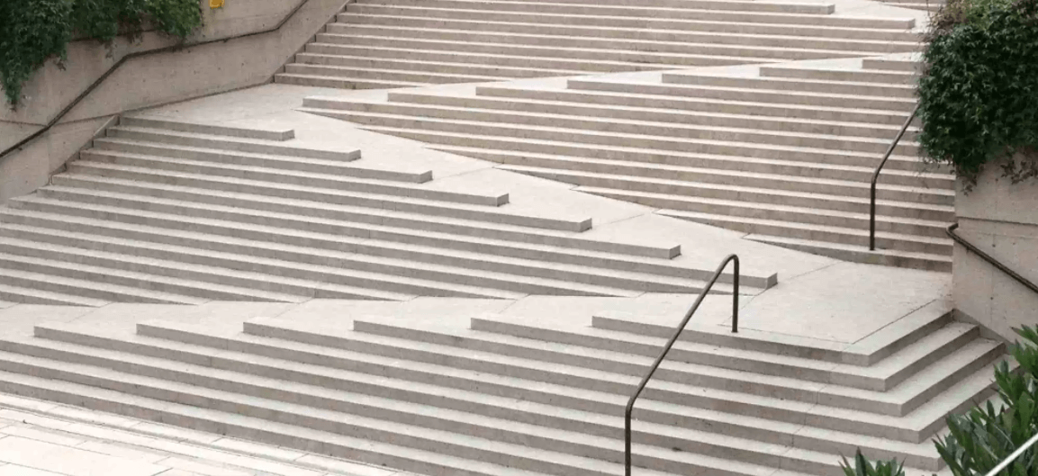
Universal and inclusive design
Picture taken by inner sydney voice: making neighborhoods accessible though universal design https://innersydneyvoice.org.au/our-resources/resources-waterloo-community-capacity-building-project/universal-design/
Notes:
Inlusive desing
Exploring the needs
Creating solutions
Evaluating how well the needs are met
Microsoft inclusive design follows the steps:
Recognize exclusion.
Solve for one, extend to many.
Learn from diversity.
Related resourses
Universal desing pictures: https://innersydneyvoice.org.au/our-resources/resources-waterloo-community-capacity-building-project/universal-design/
Microsoft inclusive design:
https://www.microsoft.com/design/inclusive/
Panel on accessibility, inclusiveness, and universality: https://accessibility.deque.com/accessibility-universal-design-inclusive-design-webinar

Slide 64
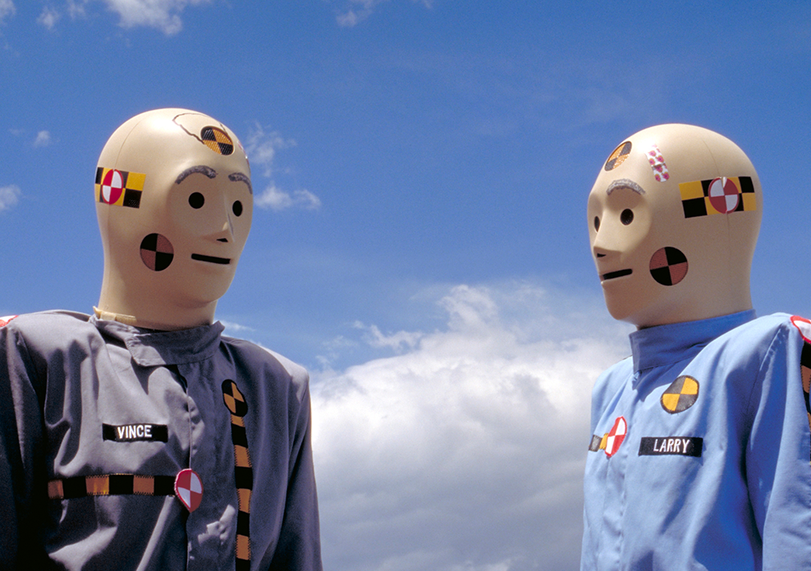
When the “other” is the designer
Picture taken from Public Health Post: It’s a crush test, dummy https://www.publichealthpost.org/research/its-the-crash-dummy/
Picture taken by Unlocking kitchens empowering girls and fighting climate change by Stéphanie Fonseca Johann https://blog-isige.minesparis.psl.eu/2020/09/25/unchocking-kitchens/
Notes:
Sugested literature:
Invisible women
https://www.amazon.com/Invisible-Women-Data-World-Designed/dp/1419729071
Crash-test Dummies
https://www.publichealthpost.org/research/its-the-crash-dummy/
https://www.consumerreports.org/car-safety/crash-test-bias-how-male-focused-testing-puts-female-drivers-at-risk/
Biomass fuel for energy
https://blog-isige.minesparis.psl.eu/2020/09/25/unchocking-kitchens/
Cellphone size
Voice recognition

Slide 65
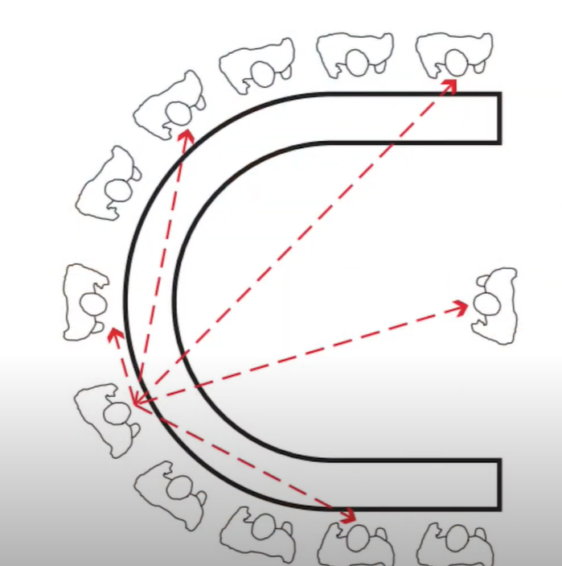
World experience / body experience
What we lose if we are unable to include diversity
Experience of life
Picture taken by https://www.gallaudet.edu/campus-design-and-planning/deafspace/
Notes:
Deaf space project:
https://www.gallaudet.edu/campus-design-and-planning/deafspace/
https://www.youtube.com/watch?v=u12uKwSwX3k
Sugested literature
The Rejected Body
https://www.amazon.com/Rejected-Body-Philosophical-Reflections-Interaction-ebook/dp/B00AZKVRWU
What Can a Body Do?: How We Meet the Built World https://www.amazon.com/What-Can-Body-Do-Built-ebook/dp/B082H35TV9/

Slide 66
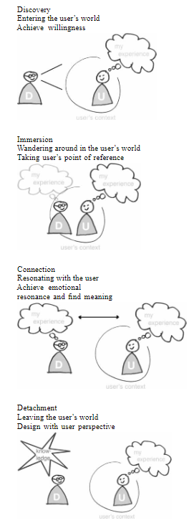
Empathy: In an out approach for designer’s blind spots
Kouprie, M., & Visser, F. S. (2009). A framework for empathy in design: stepping into and out of the user's life. Journal of Engineering Design, 20(5), 437-448.
Notes:
Empathy framework: Kouprie, M., & Visser, F. S. (2009). A framework for empathy in design: stepping into and out of the user's life. Journal of Engineering Design, 20(5), 437-448.

Slide 67
Lunch

Slide 68
Practice

Slide 69
Do and reflect while you are doing – Be back in 15-20 min
Wheelchair users
Pick one direction
Find the closest wheelchair user toilet towards that direction
Blind people – pick one (the person accompanying you is for protection not to tell you what to do)
1. Find your way to the downstairs restaurant
2. Find your way to the restaurant on the left of TellUs and find a way to understand what is the menu
3. Find your way to the toilets and try to use them (wash your hands afterword)

Slide 70
Last min discussion...
How did you feel as...blind/wheelchair user?
What do you think would have changed if you were living for years in this state of body?
Are there any risks or limitations in the way you experienced blindness/wheelchair use?
Notes:
Empathy can support us to a point, we need participation of the people who have diverse needs in the design process.
Searching for empathy (paper presentation in NordiCHI2020 talking about the preconseptions in the tools we use to design) https://www.youtube.com/watch?v=SLhfgWZUjw0
Related blog post: https://www.vasilikimylo.com/post/blind-spots-pt-1-designers

Slide 71
User center and participatory design and PPIs
Image taken from: Sanders, E. B. N., & Stappers, P. J. (2008). Co-creation and the new landscapes of design. Co-design, 4(1), 5-18.
Notes:
Suggested literature
Image taken from: Sanders, E. B. N., & Stappers, P. J. (2008). Co-creation and the new landscapes of design. Co-design, 4(1), 5-18.
General knowledge:
Participatory design: https://en.wikipedia.org/wiki/Participatory_design
User centered design: https://en.wikipedia.org/wiki/User-centered_design

Slide 72
Vasiliki Mylonopoulou https://vasilikimylo.com/ Department of Applied IT Division of Human-Computer Interaction https://hci-gu.github.io/

